Slide 1
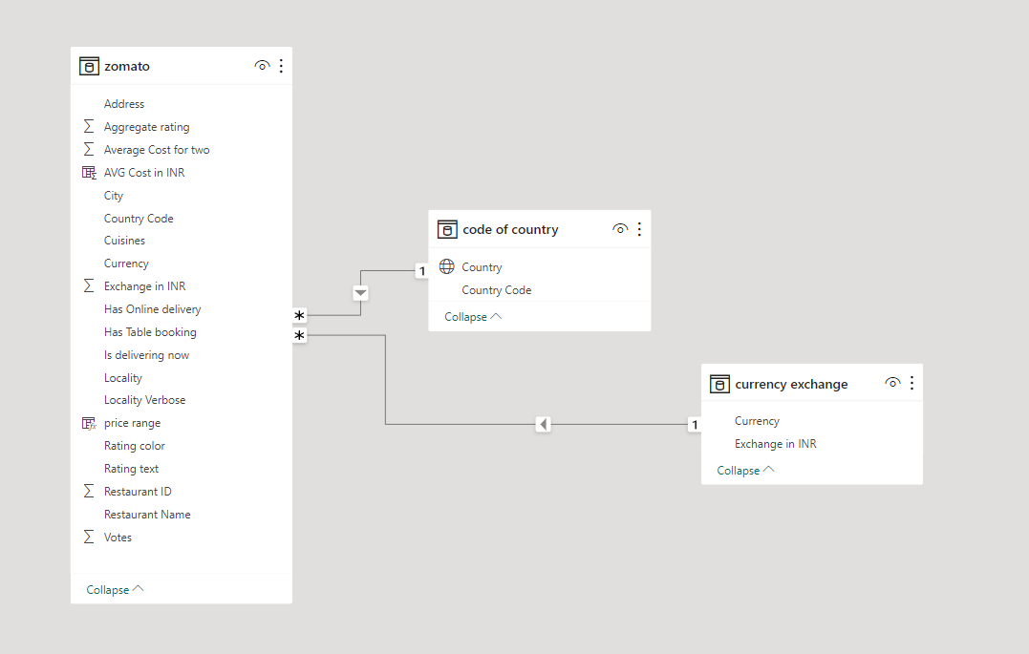
Data modelling

Slide 2

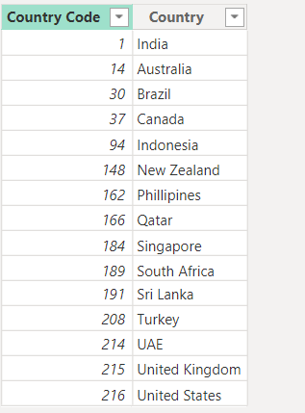
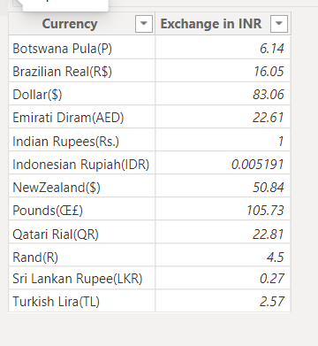
Zomato table
Currency exchange table created for exchange all other countries currency to Indian currency
Country code table

